Slide 1
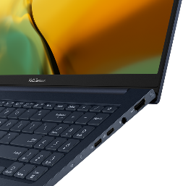


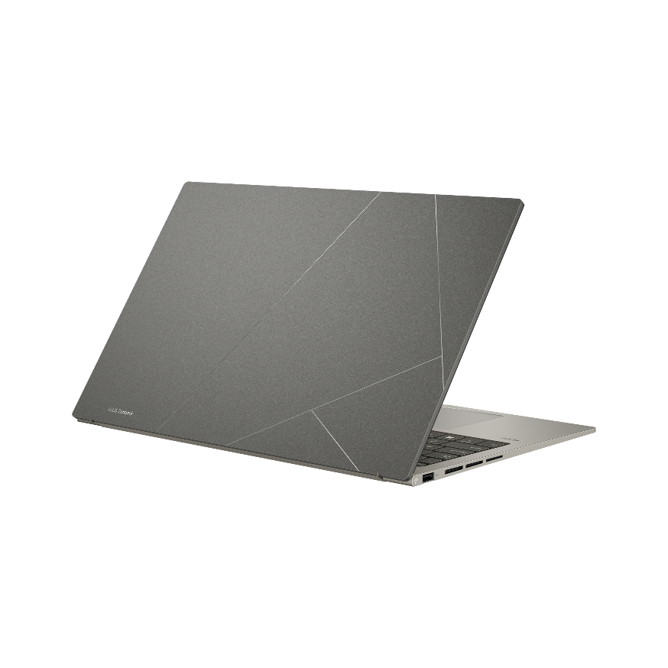
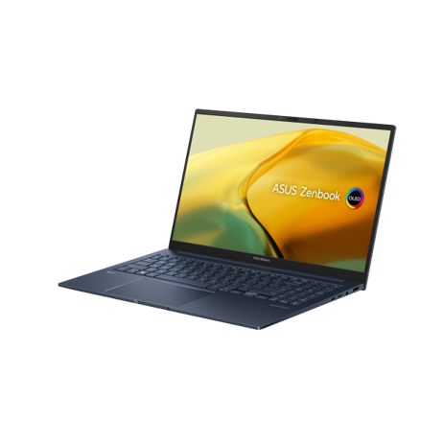















Windows 11 Pro
ANTIMICROBIAL
GUARD PLUS
FULL I/O Ports
1 x USB4 Type-C, 1 x USB 3.2 Type-C®, 1 x USB 3.2 Type-A, 1 x HDMI® 2.1, 1 x audio jack
FHD IR camera
with ambient light color sensor & 3DNR for crisp, clear video calls
Up to AMD
Ryzen™ 7735U
Processor
15.6” 2.8K OLED
​
2800 x 1620 / 16:9 / 100% DCI-P3​
67Wh
DisplayHDR
up to TrueBlack 500 certified
Average
Delta-E < 2
14.9mm / 1.4kg
Thin and Light
ASUS Zenbook 15 OLED (UM3504)
Up to
32GB
LPDDR5 6400MHz onboard memory
Up to
1TB
PCIe® Gen 4.0 x4 SSD storage
AI Noise-Canceling
and 2-mic array
noise-free video conferencing
Military grade
durability
Smart Amplifier
3.5X louder
Plasma Ceramic Aluminum
Wear resistance/ Unique look / Eco-friendly
(Basalt Gray model only)
ASUS ErgoSense
Hinge

